Slide 1


ANOVA and K-Means Clustering on Customer Dataset
D214 Capstone
Otilio Alvarado-Cruz

Slide 2
About Me
Degree in Applied Math
Student at WGU, Master’s track in Data Analytics

Slide 3
The Project
Perform K-means clustering on customer dataset, then perform ANOVA on those groups
Null Hypothesis: The groups don’t have a statistically significant mean difference in spending habits
Alternative Hypothesis: The groups do have a statistically significant mean difference in spending habits.

Slide 4
The Analysis process
Data is prepared for model
The optimal value of K for the K-Means model is found
Data is fit to the model
The groups are analyzed individually
Quality of groups is assessed by Silhouette Score
ANOVA is performed on groups

Slide 5
Data Preperation
Rows containing nulls removed
Outlier values imputed with median
Numerical columns standardized
One hot encoding on categorical columns except for shopping_mall
Frequency encoding used instead

Slide 6

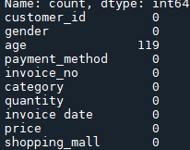
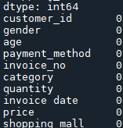
Data Preparation (cont.)

Slide 7
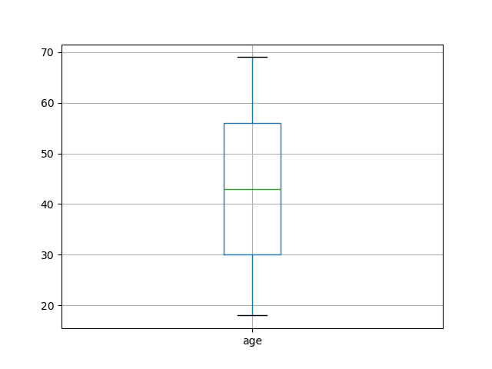
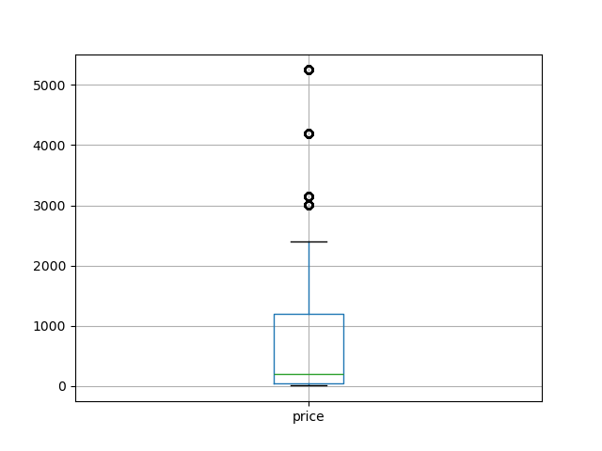
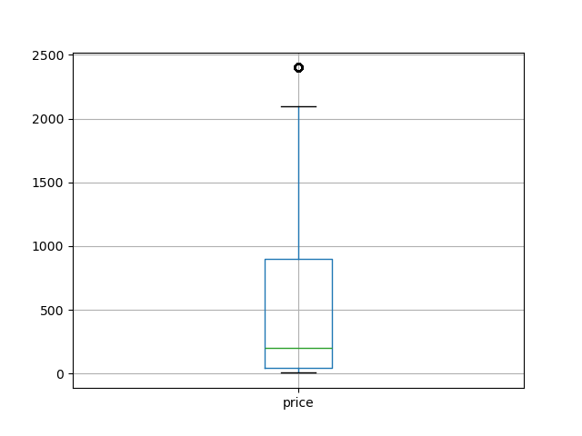
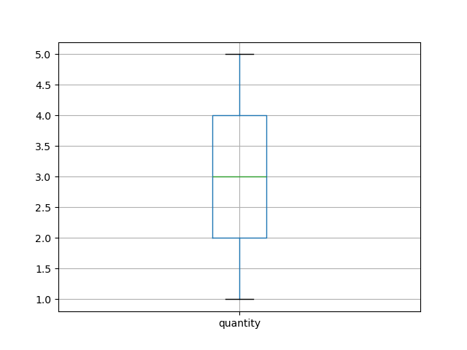
Data Preparation (cont.)

Slide 8

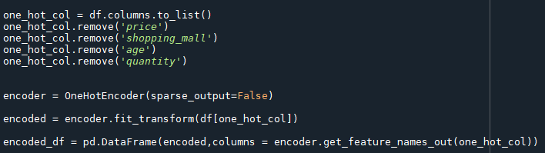
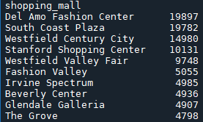
Data Preparation (cont.)
One-hot encoding is performed on categorical variables except for shopping_mall, where frequency encoding is used instead.

Slide 9
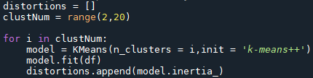
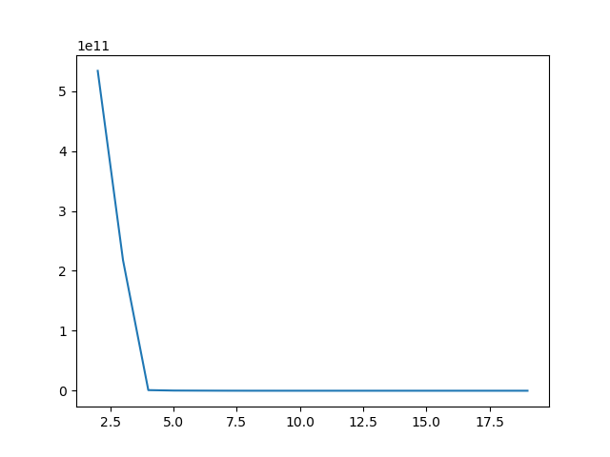
Finding Best Value of K
Elbow Method

Slide 10
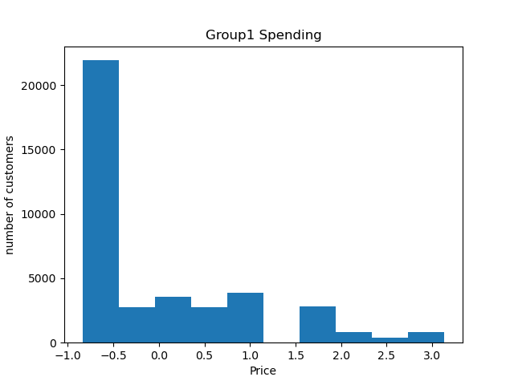
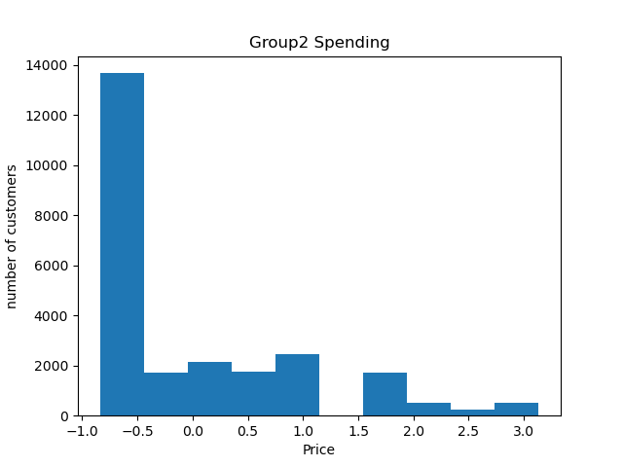
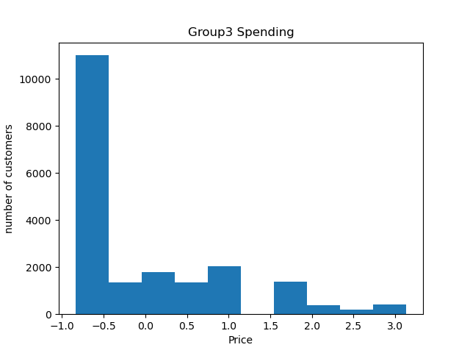

Differences in Spending Across Groups

Slide 11
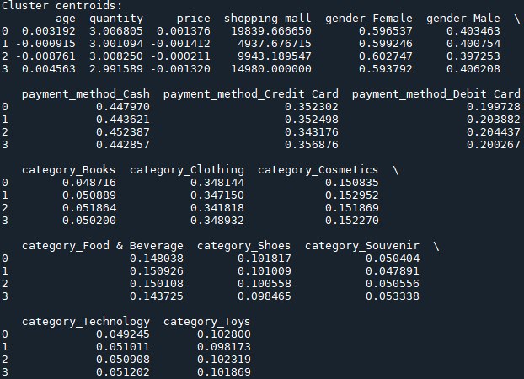
Cluster Centroids
Main difference between the groups is the shopping_mall column.

Slide 12
Final Results
Silhouette score is close to 1, indicating well separated clusters.
P-value from ANOVA is 0.98, which is greater than 0.05, indicating no significant difference in mean price variable across the four groups.

Slide 13
Limitations
Dataset is limited to 10 shopping malls in California
Pandas can be memory intensive
One-hot encoding can siginifcantly increase dimensionality of dataset
Frequency encoding can cause loss of data
Elbow for elbow method may not always be so clear
Silhouette score and ANOVA are impacted by differences in group size
The greater the differences in sample sizes between the groups, the lower the statistical power of an ANOVA (Bobbit, 2021)

Slide 14
Recommended Action
Combine data from other regions and locations
Use one group and break it down into smaller groups.

Slide 15
Benefits
Imrpove understanding in customer spending habits.
Similarity across California malls indicates spending habits across a region likely to be similar.

Slide 16
Sources
Bobbitt, Zach. “How to Perform an ANOVA with Unequal Sample Sizes.” Statology, 18 Sept. 2021, www.statology.org/anova-unequal-sample-size/?utm_source=chatgpt.com.

